Slide 1
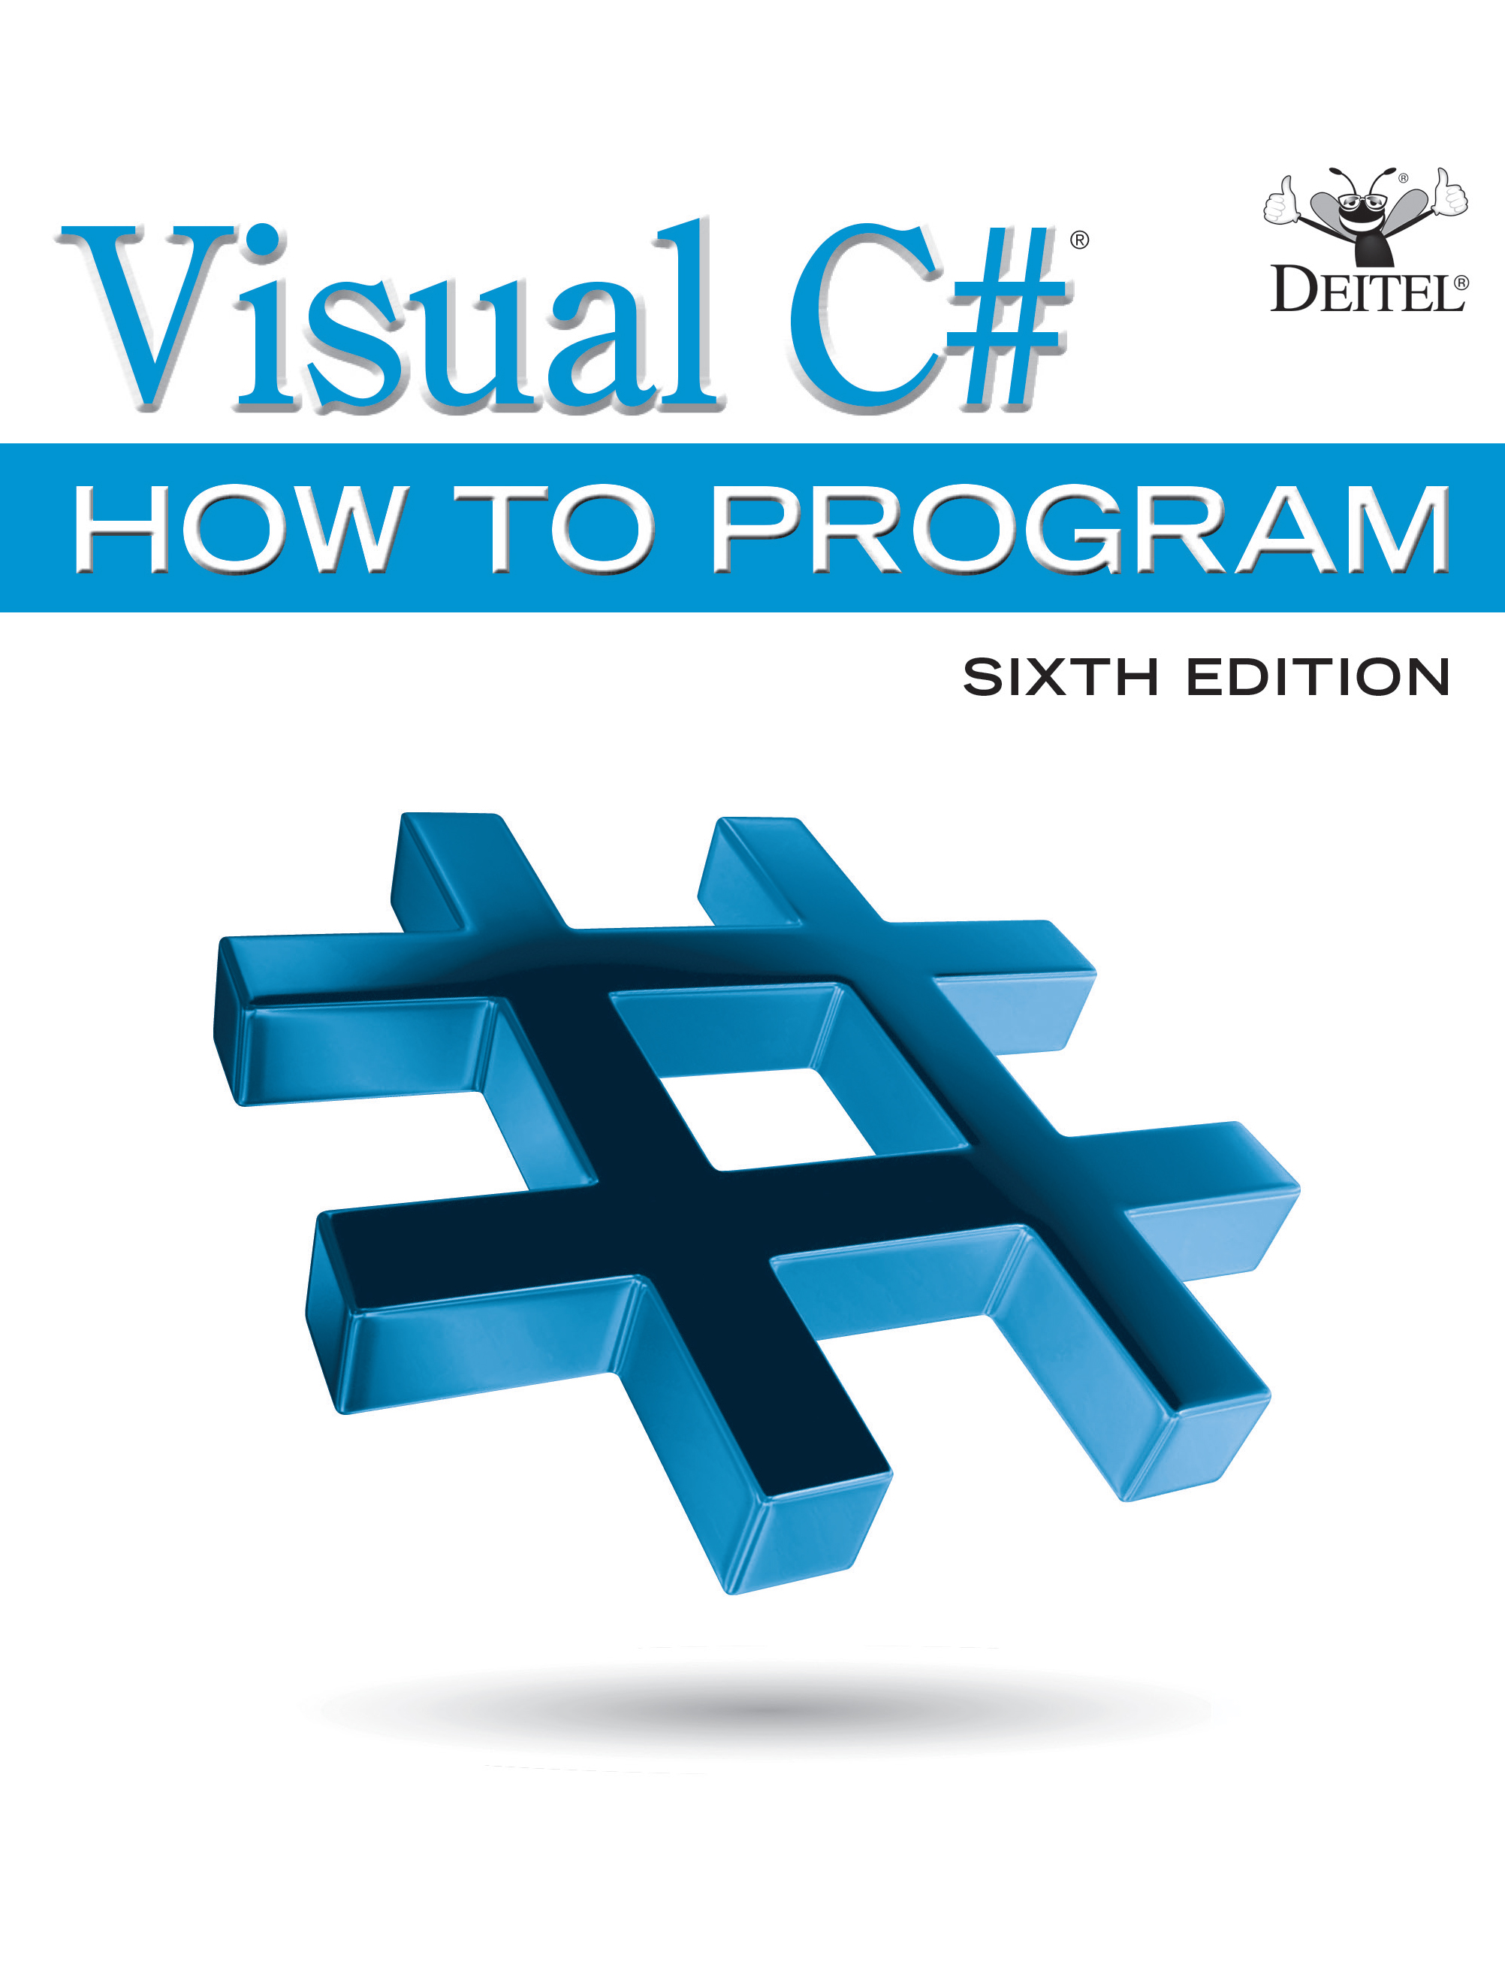
Visual C sharp® How to Program
Sixth Edition
Chapter 20
Generics
Copyright © 2017 Pearson Education, Inc. All Rights Reserved
Notes:
If this PowerPoint presentation contains mathematical equations, you may need to check that your computer has the following installed:
1) MathType Plugin
2) Math Player (free versions available)
3) NVDA Reader (free versions available)

Slide 2
Learning Objectives
Create generic methods that perform identical tasks on arguments of different types.
Create a generic Stack class that can be used to store objects of a specific type.
Understand how to overload generic methods with nongeneric methods or withother generic methods.
Understand the kinds of constraints that can be applied to a type parameter.
Apply multiple constraints to a type parameter.

Slide 3
Outline
20.1 Introduction
20.2 Motivation for Generic Methods
20.3 Generic-Method Implementation
20.4 Type Constraints
20.4.1 IComparable<T> Interface
20.4.2 Specifying Type Constraints
20.5 Overloading Generic Methods
20.6 Generic Classes
20.7 Wrap-Up

Slide 4
20.2 Motivation for Generic Methods
Overloaded methods are often used to perform similar operations on different types of data.
To understand the motivation for generic methods, let’s begin with an example (Figure 20.1) that contains three overloaded DisplayArray methods.
These methods display the elements of an int array, a double array and a char array, respectively.
Soon, we’ll reimplement this program more concisely and elegantly using a single generic method

Slide 5
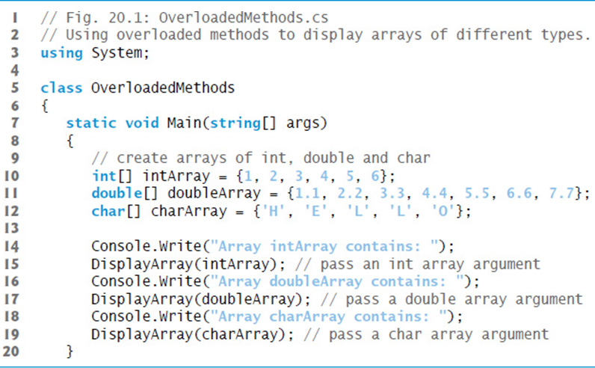
Figure 20.1 Using Overloaded Methods to Display Arrays of Different Types (1 of 3)

Slide 6
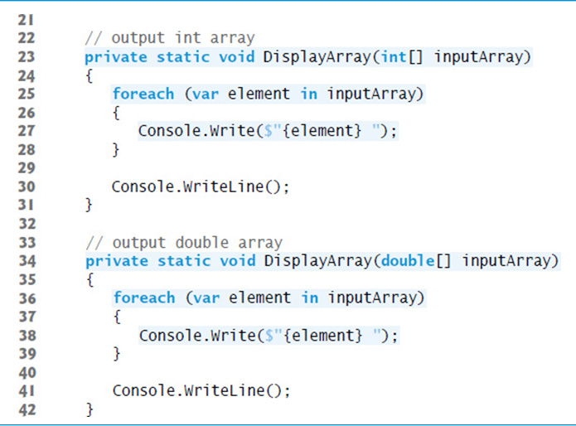
Figure 20.1 Using Overloaded Methods to Display Arrays of Different Types (2 of 3)

Slide 7
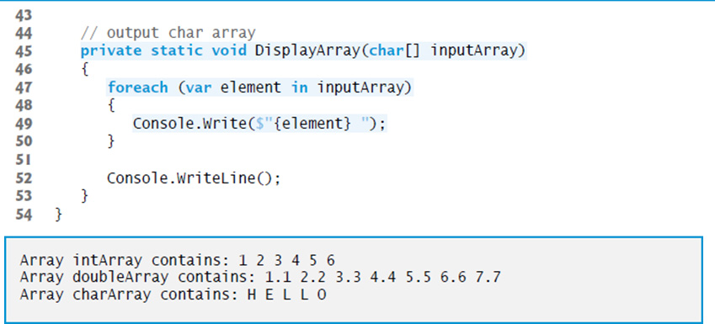
Figure 20.1 Using Overloaded Methods to Display Arrays of Different Types (3 of 3)

Slide 8
20.3 Generic-Method Implementation (1 of 3)
Figure 20.3 reimplements the app of Figure 20.1 using a generic DisplayArray method
Note that the DisplayArray method calls in lines 15, 17 and 19 are identical to those of Figure 20.1, the outputs of the two apps are identical and the code in Figure 20.3 is 22 lines shorter than that in Figure 20.1.
As illustrated in Figure 20.3, generics enable us to create and test our code once, then reuse it for many different types of data.
This effectively demonstrates the expressive power of generics.

Slide 9
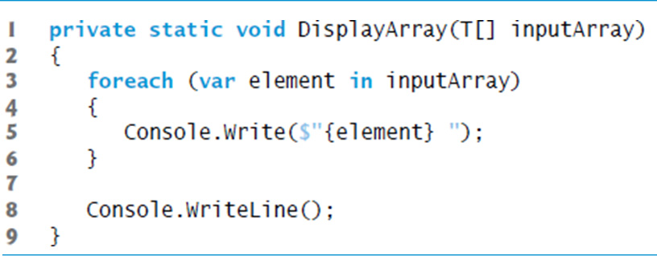
Figure 20.2 Display Array Method In Which Actual Type Names Have Been Replaced By Convention With The Generic Name T. Again, This Code Will Not Compile

Slide 10
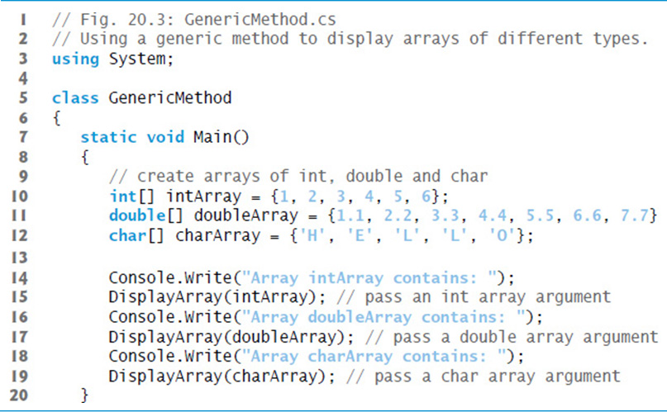
Figure 20.3 Using a Generic Method to Display Arrays of Different Types (1 of 2)

Slide 11
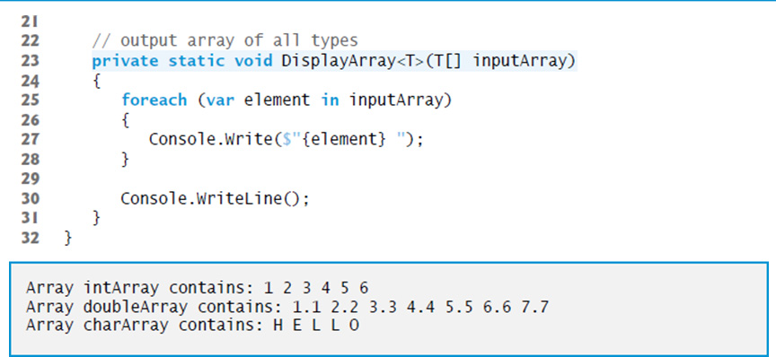
Figure 20.3 Using a Generic Method to Display Arrays of Different Types (2 of 2)

Slide 12
Common Programming Error 20.1
If you forget to include the type-parameter list when declaring a generic method, the compiler will not recognize the type-parameter names when they’re encountered in the method. This results in compilation errors.

Slide 13
Common Programming Error 20.2
If the compiler cannot find a single nongeneric or generic method declaration that’s a best match for a method call, or if there are multiple best matches, a compilation error occurs.

Slide 14
20.3 Generic-Method Implementation (2 of 3)
Value Types vs. Reference Types in Generics
The compiler handles value and reference types differently in generic method calls.
When a value-type argument is used for a given type parameter, the compiler generates a version of the method that’s specific to the value type—if one has been generated previously, the compiler reuses that one.
If DisplayArray were called with a reference type, the compiler would also generate a single version of the method that’s used by all reference types.

Slide 15
20.3 Generic-Method Implementation (3 of 3)
Explicit Type Arguments
You also can use explicit type arguments to indicate the exact type that should be used to call a generic function. For example, line 15 could be written as
The preceding method call explicitly provides the type argument (int) that should be used to replace type parameter T in line 23.
Though not required here, an explicit type argument would be required if the compiler cannot infer the type from the method’s argument(s).

Slide 16
20.4 Type Constraints (1 of 7)
IComparable<T> Interface
It’s possible to compare two objects of the same type if that type implements the generic interface IComparable<T> (of namespace System).
A benefit of implementing interface IComparable<T> is that IComparable<T> objects can be used with the sorting and searching methods of classes in the System.Collections.Generic namespace—we discuss those methods in Chapter 21.
The structures in the Framework Class Library that correspond to the simple types all implement this interface.

Slide 17
20.4 Type Constraints (2 of 7)
Specifying Type Constraints
Even though IComparable objects can be compared, they cannot be used with generic code by default, because not all types implement interface IComparable<T>.
However, we can restrict the types that can be used with a generic method or class to ensure that they meet certain requirements.
This feature—known as a type constraint—restricts the type of the argument supplied to a particular type parameter.

Slide 18
20.4 Type Constraints (3 of 7)
Figure 20.4 declares method Maximum (lines 18–35) with a type constraint that requires each of the method’s arguments to be of type IComparable<T>.
This restriction is important, because not all objects can be compared.
However, all IComparable<T> objects are guaranteed to have a CompareTo method that can be used in method Maximum to determine the largest of its three arguments.

Slide 19
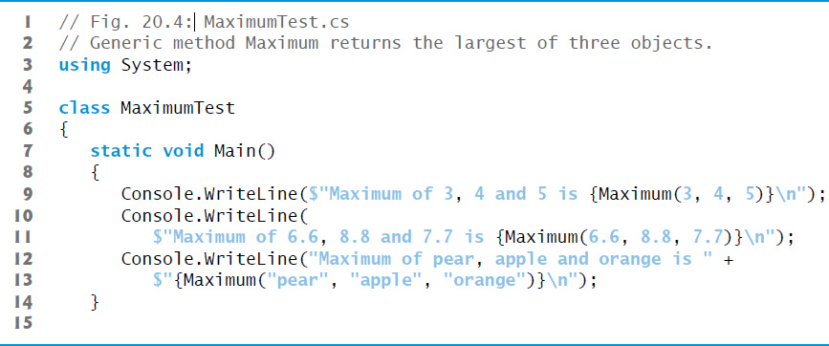
Figure 20.4 Generic Method Maximum Returns the Largest of Three Objects (1 of 3)

Slide 20
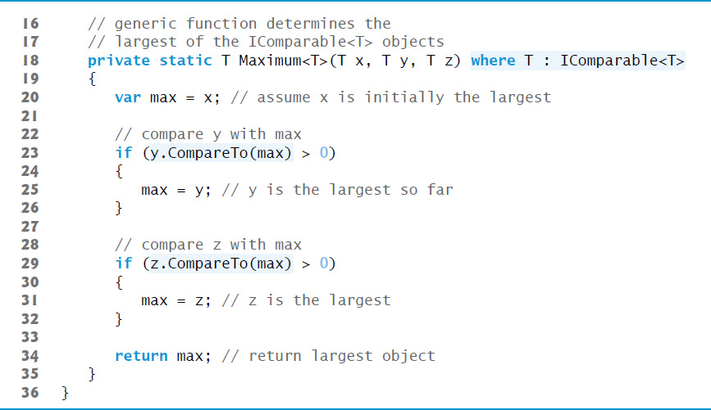
Figure 20.4 Generic Method Maximum Returns the Largest of Three Objects (2 of 3)

Slide 21

Figure 20.4 Generic Method Maximum Returns the Largest of Three Objects (3 of 3)

Slide 22
20.4 Type Constraints (4 of 7)
provides several kinds of type constraints.
A class constraint indicates that the type argument must be an object of a specific base class or one of its subclasses.
An interface constraint indicates that the type argument’s class must implement a specific interface.
The type constraint in line 18 is an interface constraint, because IComparable<T> is an interface.

Slide 23
20.4 Type Constraints (5 of 7)
You can specify that the type argument must be a reference type or a value type by using the reference-type constraint (class) or the value-type constraint (struct), respectively.
Finally, you can specify a constructor constraint—new()—to indicate that the generic code can use operator new to create new objects of the type represented by the type parameter.

Slide 24
20.4 Type Constraints (6 of 7)
If a type parameter is specified with a constructor constraint, the type argument’s class must provide a public parameterless or default constructor to ensure that objects of the class can be created without passing constructor arguments; otherwise, a compilation error occurs.
It’s possible to apply multiple constraints to a type parameter.

Slide 25
20.4 Type Constraints (7 of 7)
To do so, simply provide a comma-separated list of constraints in the where clause.
If you have a class constraint, reference-type constraint or value-type constraint, it must be listed first—only one of these types of constraints can be used for each type parameter.
Interface constraints (if any) are listed next.
The constructor constraint is listed last (if there is one).

Slide 26
20.5 Overloading Generic Methods
A generic method may be overloaded.
Each overloaded method must have a unique signature (as discussed in Chapter 7).
A class can provide two or more generic methods with the same name but different method parameters.
A generic method can be overloaded by nongeneric methods with the same method name.
When the compiler encounters a method call, it searches for the method declaration that best matches the method name and the argument types specified in the call.

Slide 27
20.6 Generic Classes (1 of 5)
With a generic class, you can use a simple, concise notation to indicate the actual type(s) that should be used in place of the class’s type parameter(s).
At compilation time, the compiler ensures your code’s type safety, and the runtime system replaces type parameters with type arguments to enable your client code to interact with the generic class.

Slide 28
20.6 Generic Classes (2 of 5)
One generic Stack class, for example, could be the basis for creating many Stack classes (e.g., “Stack of double,” “Stack of int,” “Stack of char,” “Stack of Employee”).
Figure 20.5 presents a generic Stack class declaration.
This class should not be confused with the class Stack from namespace System.Collections.Generics.

Slide 29
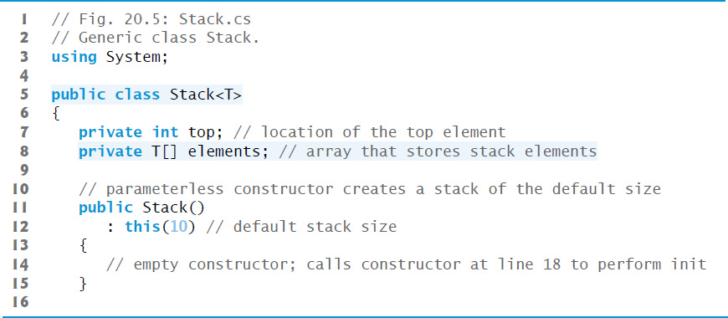
Figure 20.5 Generic Class Stack (1 of 4)

Slide 30
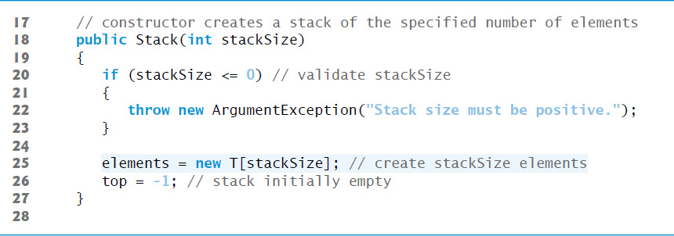
Figure 20.5 Generic Class Stack (2 of 4)

Slide 31
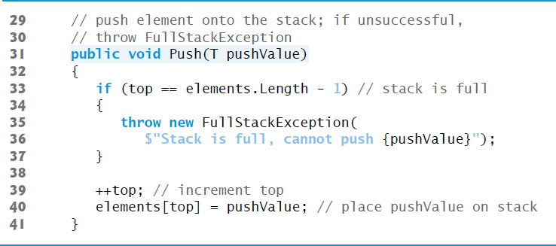
Figure 20.5 Generic Class Stack (3 of 4)

Slide 32
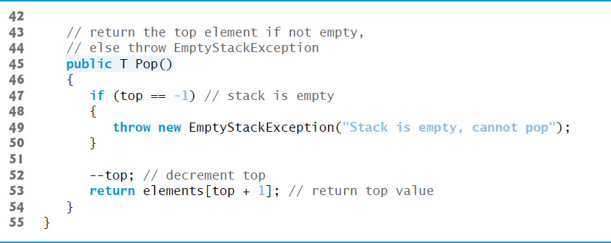
Figure 20.5 Generic Class Stack (4 of 4)

Slide 33
20.6 Generic Classes (3 of 5)
Classes FullStackException (Figure 20.6) and EmptyStackException (Figure 20.7) each provide a parameterless constructor, a one-argument constructor of exception classes (as discussed in Section 13.8) and a two-argument constructor for creating a new exception using an existing one.
The parameterless constructor sets the default error message while the other two constructors set custom error messages.

Slide 34
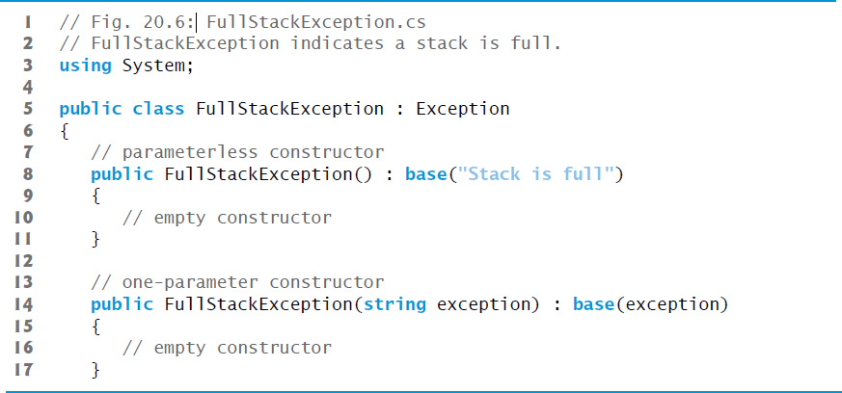
Figure 20.6 Fullstackexception Indicates a Stack is Full (1 of 2)

Slide 35
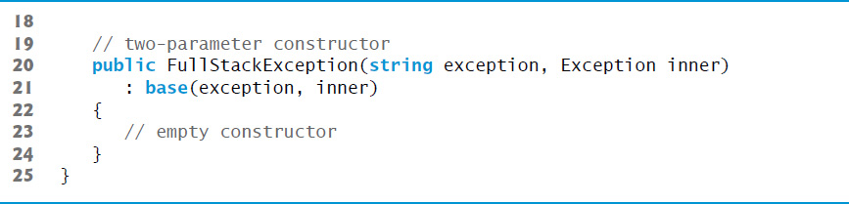
Figure 20.6 Fullstackexception Indicates a Stack is Full (2 of 2)

Slide 36
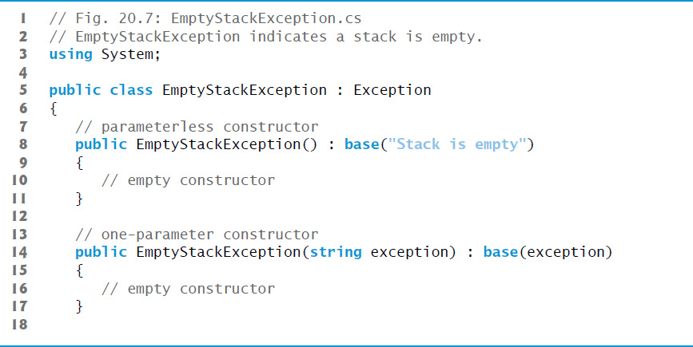
Figure 20.7 Emptystackexception Indicates a Stack is Empty (1 of 2)

Slide 37
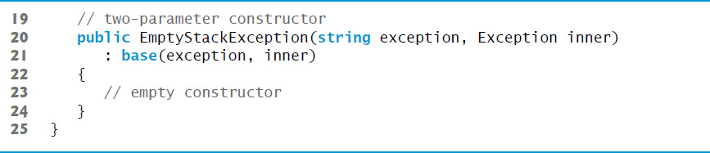
Figure 20.7 Emptystackexception Indicates a Stack is Empty (2 of 2)

Slide 38
20.6 Generic Classes (4 of 5)
Now, let’s consider an app (Figure 20.8) that uses the Stack generic class.

Slide 39
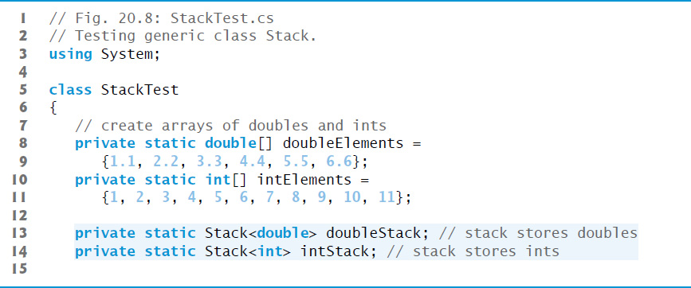
Figure 20.8 Testing Generic Class Stack (1 of 8)

Slide 40
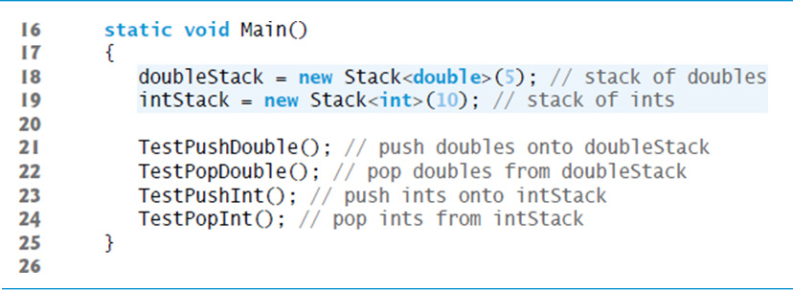
Figure 20.8 Testing Generic Class Stack (2 of 8)

Slide 41
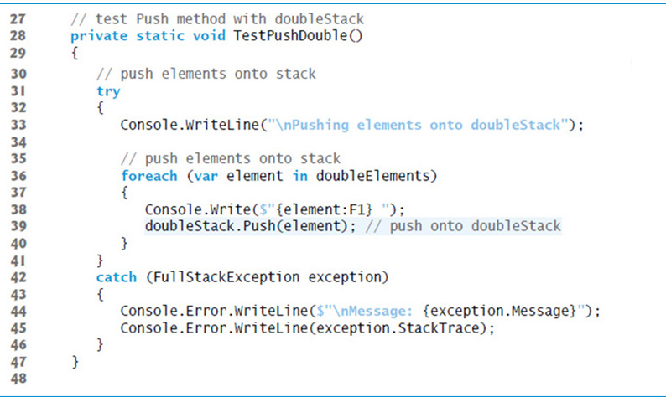
Figure 20.8 Testing Generic Class Stack (3 of 8)

Slide 42
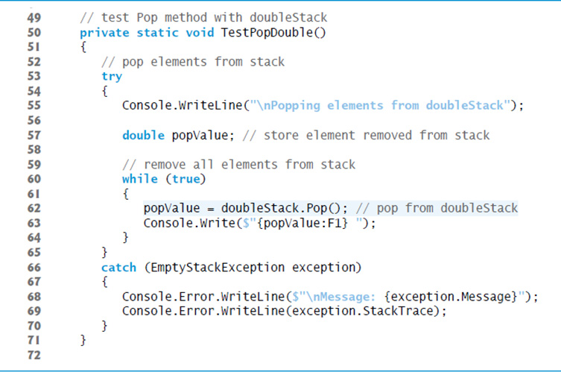
Figure 20.8 Testing Generic Class Stack (4 of 8)

Slide 43
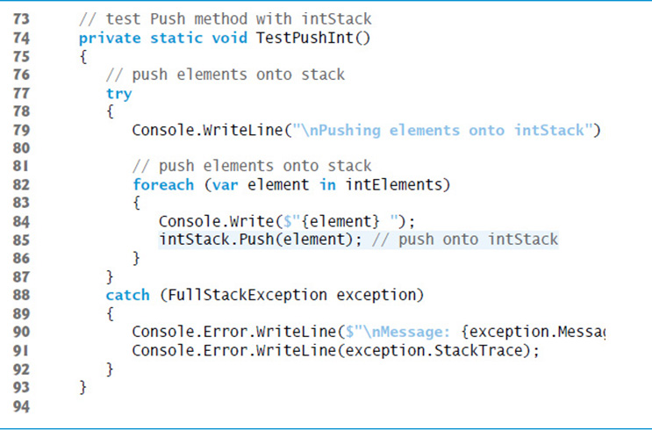
Figure 20.8 Testing Generic Class Stack (5 of 8)

Slide 44
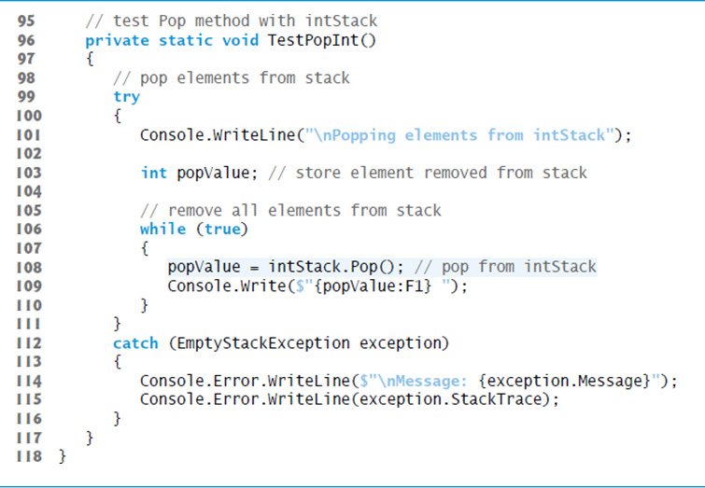
Figure 20.8 Testing Generic Class Stack (6 of 8)

Slide 45
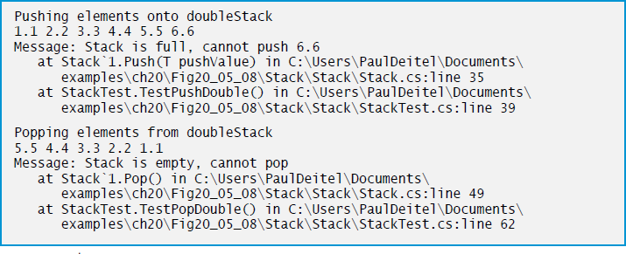
Figure 20.8 Testing Generic Class Stack (7 of 8)

Slide 46
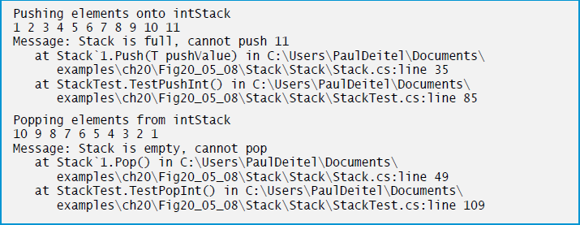
Figure 20.8 Testing Generic Class Stack (8 of 8)

Slide 47
20.6 Generic Classes (5 of 5)
Figure 20.9 declares generic method TestPush (lines 33–53) to perform the same tasks as TestPushDouble and TestPushInt in Figure 20.8—that is, Push values onto a Stack<T>.
Similarly, generic method TestPop (lines 56–77) performs the same tasks as TestPopDouble and TestPopInt in Figure 20.8—that is, Pop values off a Stack<T>.

Slide 48
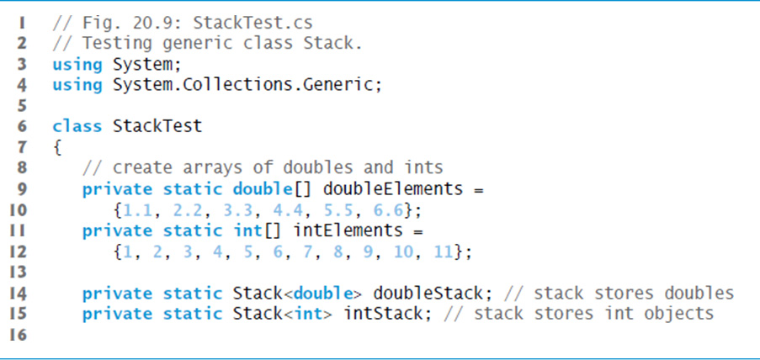
Figure 20.9 Testing Generic Class Stack (1 of 6)

Slide 49
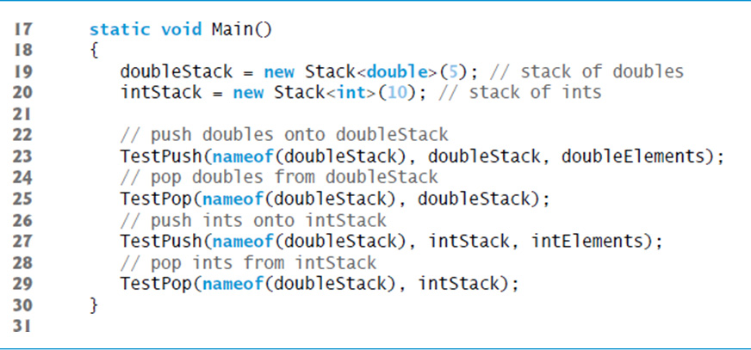
Figure 20.9 Testing Generic Class Stack (2 of 6)

Slide 50
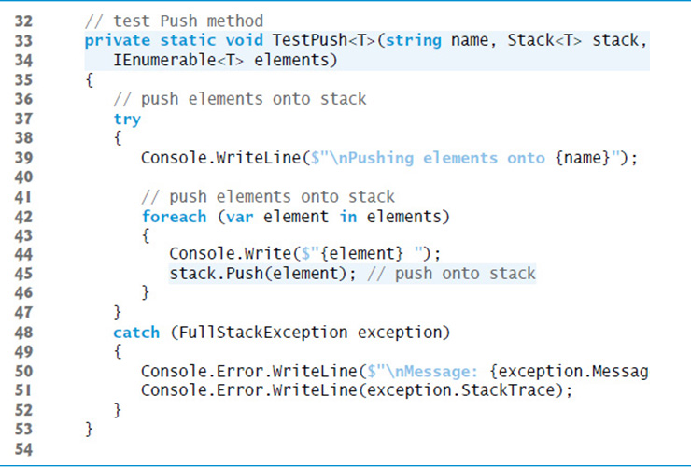
Figure 20.9 Testing Generic Class Stack (3 of 6)

Slide 51
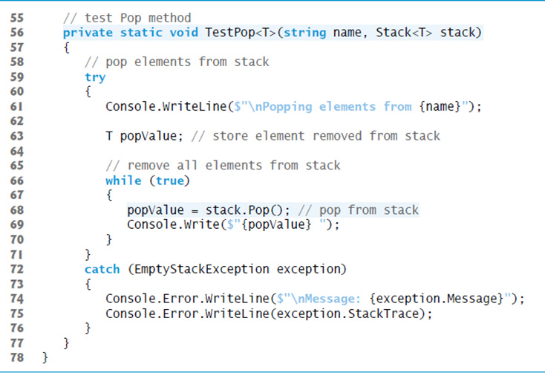
Figure 20.9 Testing Generic Class Stack (4 of 6)

Slide 52
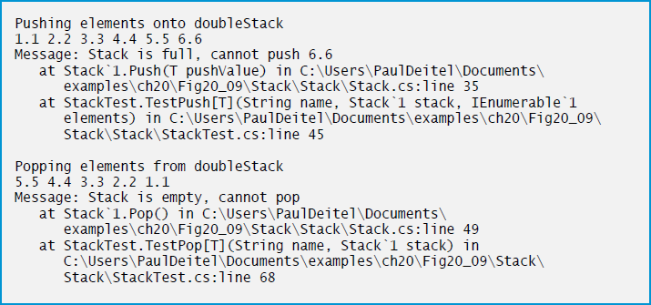
Figure 20.9 Testing Generic Class Stack (5 of 6)

Slide 53
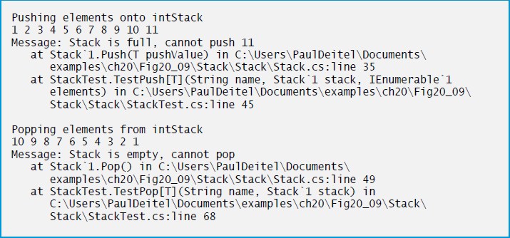
Figure 20.9 Testing Generic Class Stack (6 of 6)

Slide 54

Copyright

